Slide 1

GoldZIP Gold Bar Standard
2021.07.29 - Layout temp V1

Slide 2
GoldZIP
Brand | Logo | Description | Assay Seal | Bar Number
PAMP | Yes | SUISSE 1 KILO FINE GOLD 999.9 | PAMP Essayeur Fondeur | Yes
Valcombi | Yes | SUISSE 1Kg gold 999,9 | CHI Essayeur Fondeur | Yes
Metalor | Yes | 1 KILO GOLD 999.9 SWITZERLAND | MP Essayeur Fondeur (MP = Metalor Product) | Yes
Argor Heraeus | Yes | SWITZERLAND 1 KILO FINE GOLD 999,9 | Argor Heraeus Melter Assayer | Yes
Shandong Gold | Yes | 1000g Au 9999 | Nil | Yes
Credit Suisse | Yes | 1 KILO Gold 999.9 | CHI Essayeur Fondeur | Yes
ABC | Yes | 1 KILO FINE GOLD 999.9 | AUSTRALIA | Yes
Asahi USA | Yes | 1 KILO FINE GOLD 9999 | NIL | YES
Royal Canadian Mint | Yes | 1 KILO GOLD 999.9 | NIL | YES
Gold Bar description (from Valcombi Website)
Minted bars (sometimes called wafers) are cut from specially prepared rolled metal sheets. Our bars have a very high-quality finish, guaranteed purity and are produced in the same facility as our minted coins. Our standard minted bars show Valcambi's Hallmark (logo, weight, metal name, fineness, essayeur fondeur and bar number). On the reverse is written Valcambi Suisse. Our old standard minted bars show only Valcambi's name on both sides.
ESSAYEUR FONDEUR
In direct translation, ‘essayeur fondeur’ means ‘assayer founder’. The real importance of these two words however is that they are the official stamp of the refinery that manufactured the bullion bars on which they appear. Of the 5 world-class bullion refineries in Switzerland, four of them use the mark ‘Essayeur Fondeur’ on their bars. Only Argor-Heraeus bars differ in that they use the English words ‘Melter Assayer’ which is probably a better and more accurate translation for ‘essayeur fondeur’.

Slide 3
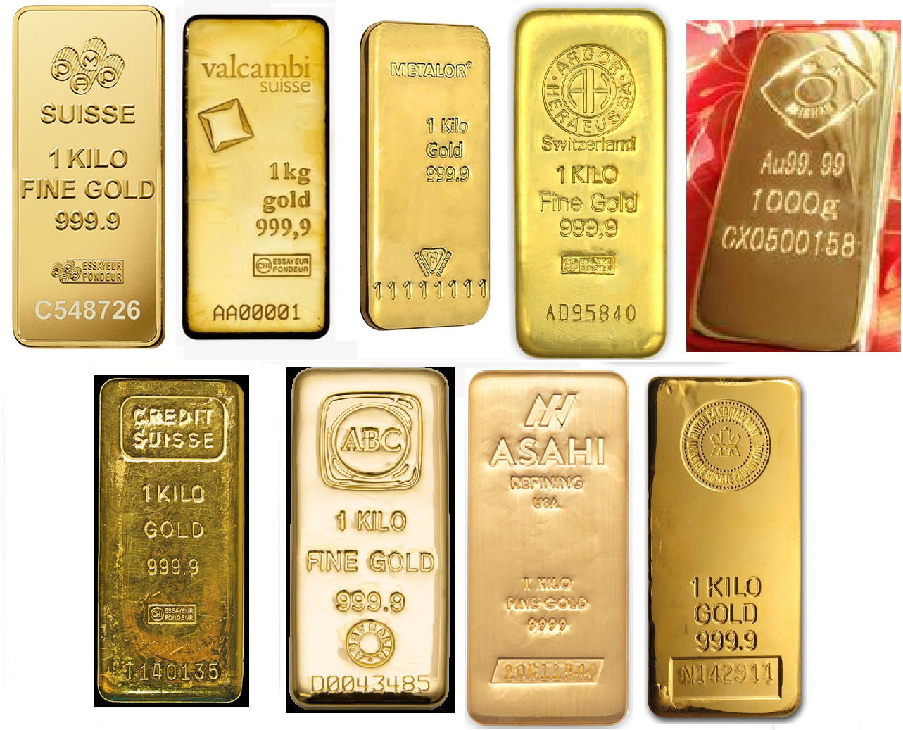
GoldZIP
Popular 1kg Gold Bar Description
PAMP
Valcombi
Metalor
Argor Heraeus
Shandong Gold
Credit Suisse
ABC
Asahi USA
Royal Canadian Mint
ESSAYEUR FONDEUR為法文，是瑞士製造的保證標章，全球只有5間設在瑞士的鑄造廠，有資格在產品上鑄印此字樣。除了「Argor-Heraeus」鑄造廠，以英文「Melter Assayer」鑄印，包括Credit Suisse在內的其餘四家鑄造廠，皆以法文字樣印製。

Slide 4
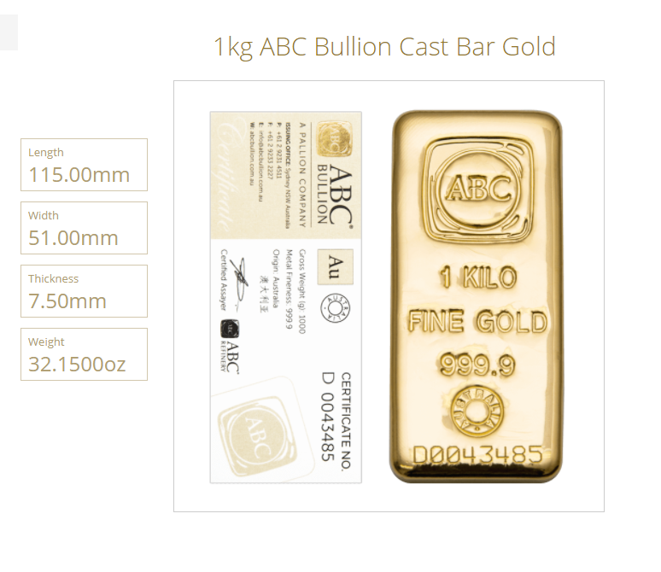
GoldZIP
Popular 1kg Gold Bar Description | Length (mm) | Width (mm) | Thickness (mm)
Argor Heraeus | 117.5 | 52 | 9
ABC | 115 | 51 | 7.5
PAMP | 115.5 | 52.5 | 9.2
Metalor | 117 | 52 | 9
Valcombi | 117 | 53 | -
CPM | 116 | 52 | 8 – 10
GoldZIP Bar | 117 | 53 | 8 – 10
Sample
Reference link:
Argor Heraeus
https://www.argor.com/en/activities/bars-coins/1kg-au-9999-chain-custody
Valcambi
https://www.valcambi.com/products-and-metals/cast-products/au/1000-g/gold-kilobar-9999/
PAMP
https://www.pamp.com/castbars/AU00RI013Q999
Metalor
https://metalor.com/wp-content/uploads/2020/11/201117-BGI-Gold-kilobar.pdf
Heraeus kilo gold bar dimension
https://www.heraeus.com/media/media/hpm/doc_hpm/Flyer_Bars.pdf

Slide 5
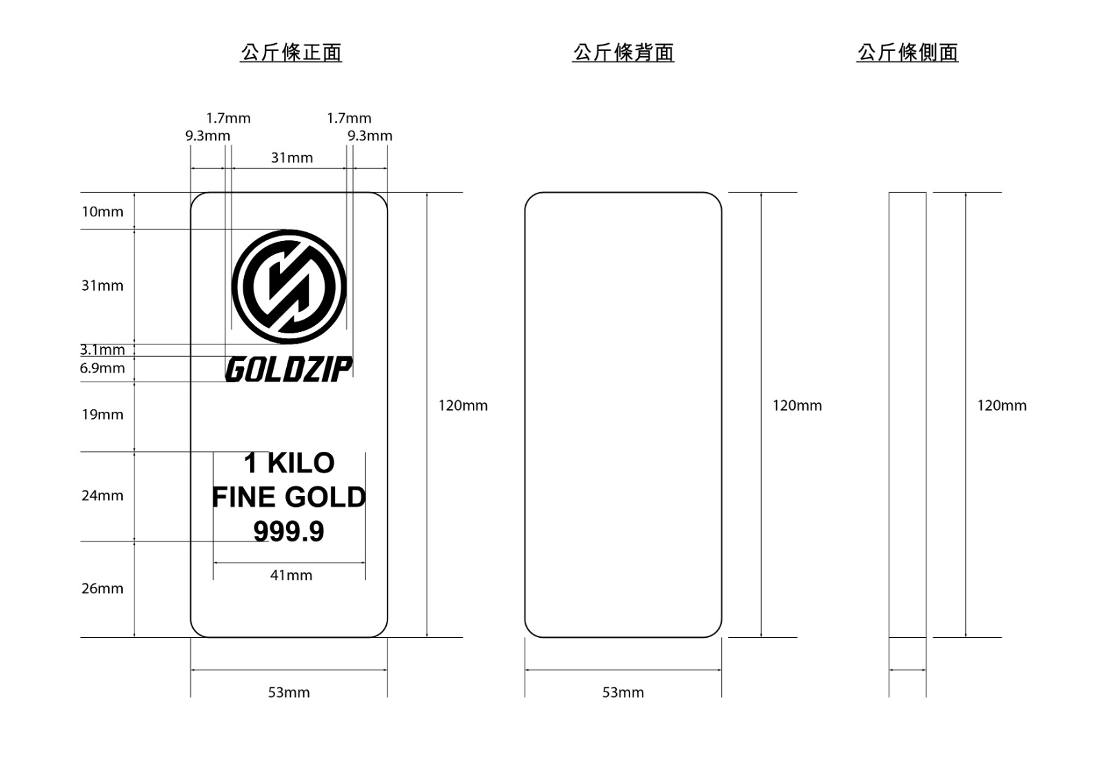
GoldZIP
8-10mm
LOGO (GoldZIP)
1 KILO
FINE GOLD
999.9
Bar Number 6 Digit Numbers
(e.g. A00001)
16mm
117mm
A00001

